Slide 1
Evidenze per la terapia sostitutiva con testosterone (TRT)
Prof. Ridwan Shabsigh

Slide 2
Benefici potenziali della TRT
Negli uomini affetti da ipogonadismo la TRT offre una serie di benefici potenziali:
- Aumento della massa muscolare scheletrica e possibile aumento della forza
- Diminuzione della massa grassa
- Miglioramento della libido ed eventualmente della funzione erettile
- Aumento della densità minerale ossea
- Riduzione degli eventi cardiovascolari
- Miglioramento dell’umore
- Miglioramento della funzione cognitiva
- Aumento RBC
- Riduzione del grasso corporeo
- Riduzione della circonferenza addominale
- Riduzione della glicemia
- Riduzione dei trigliceridi
- Miglioramento della sensibilità insulinica
- Può facilitare la gestione della sindrome metabolica e ridurne le possibili conseguenze (Diabete mellito di tipo 2, malattia cardiovascolare)
Tung DS & Cunningham GR. Endocrinologist 2007;17(2):101–115; Traish AM et al. Am J Med 2011;24;578–597.
Notes:
References
Tung DS & Cunningham GR. Androgen deficiency in men. Endocrinologist. 2007;17(2):101–115.<<Ap105 Table 5.>>
Traish AM, Miner MM, Morgentaler A, Zitzman M. Testosterone deficiency. Am J Med. 2011;24;578–597. <<Ap581>>

Slide 3
Il testosterone migliora la funzione muscolare e la forza (2)
Variazioni nella misurazione della performance muscolare e della funzione fisica dal baseline fino a fine studio su 209 uomini anziani fragili (età media 74 anni) sottoposti a terapia con T
** P=0.003
*** p=0.004
** p=0.05
*** p=0.002
*** p=0.05
** p=0.002
Differenza tra trattamenti
Basaria S et al. New Engl J Med 2010;363:109–122.
Notes:
References
Basaria S et al. New Engl J Med 2010;363:109–122.<<Ap120 Table .>>

Slide 4
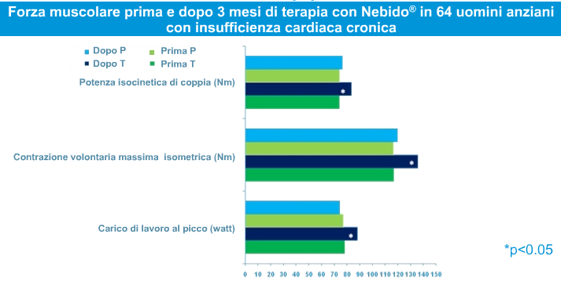
Il testosterone migliora la performance muscolare e la forza (3)
*
*
*
P- placebo; T-testosterone; Nm – Newton metro
Caminiti G et al. J Am Coll Cardiol 2009;54:919–927.
Notes:
Reference
Caminiti G, Volterrani M, Iellamo F et al. Effect of long-acting testosterone treatment on functional exercise capacity, skeletal muscle performance, insulin resistance, and baroreflex sensitivity in elderly patients with chronic heart failure a double-blind, placebo-controlled, randomized study. J Am Coll Cardiol. 2009 Sep 1;54(10):919-27.
4

Slide 5
Il testosterone migliora la performance muscolare e la forza (4)
Variazioni nell’estensione e nella flessione isometrica e isocinetica del ginocchio (parametri della forza muscolare degli arti inferiori). Studio su 262 uomini anziani deboli dopo sei mesi di terapia con testosterone gel
**
Srinivas-Shankar U et al. J Clin Endocrinol Metab 2010;95(2):639–650.
Notes:
References
Srinivas-Shankar U, Roberts SA, Connolly MJ, et al. Effects of testosterone on muscle strength, physical function, body composition, and quality of life in intermediate-frail and frail elderly men: a randomized, double-blind, placebo-controlled study. J Clin Endocrinol Metab. 2010;95(2):639–650.<<Ap644 Table 2.>>

Slide 6
Il testosterone migliora l’insulino-resistenza (1)
Variazione dalla baseline in HOMA -IR dopo 12 mesi di placebo (n=10) o TU (n=40); i pazienti sono passati dal placebo al testosterone undecanoato (P^TU) dopo 12 mesi, per un totale di 24 mesi
12 mesi
24 mesi
p=0.001
Aversa A et al. J Sex Med 2010;7(10):3495–3503.
Notes:
Notes
AIM: To evaluate the effects of parenteral testosterone undecanoate (TU) in outclinic patients with metabolic syndrome (MS) and late-onset hypogonadism (total testosterone (T) at or below 11nmol/L or free T at or below 250pmol/L).
METHODS: This is a randomized, double-blind, double-dummy, placebo-controlled, parallel group, single-center study. Fifty patients (mean age 57±8) were randomized (4:1) to receive TU 1,000mg (every 12 weeks) or placebo (PLB) gel (3-6 g/daily) for 24 months.
MAIN OUTCOME MEASURES: Homeostasis model assessment index of insulin resistance (HOMA-IR), carotid intima media thickness (CIMT), and high-sensitivity C-reactive protein (hsCRP).
RESULTS: At baseline, all patients fulfilled the National Cholesterol Education Program-Third Adult Treatment Panel (NCEP-ATPIII) and International Diabetes Federation (IDF) criteria for the definition of MS. An interim analysis conducted at 12 months showed that TU markedly improved HOMA-IR (P <0.001), CIMT (P<0.0001), and hsCRP (P<0.001) compared with PLB; thus, all patients were shifted to TU treatment. After 24 months, 35% (P< 0.0001) and 58% (P < 0.001) of patients still presented MS as defined by NCEP-ATPIII and IDF criteria, respectively. Main determinants of changes were reduction in waist circumference (P<0.0001), visceral fat mass (P<0.0001), and improvement in HOMA-IR without changes in body mass index (BMI).
CONCLUSIONS: TU reduced fasting glucose, waist circumference, and improved surrogate markers of atherosclerosis in hypogonadal men with MS. Resumption and maintenance of T levels in the normal range of young adults determines a remarkable reduction in cardiovascular risk factors clustered in MS without significant hematological and prostate adverse events.
The study seems to be valued highly by the Journal of Clinical Endocrinology and Metabolism as it was highlighted by an editorial by Shalender Bhasin. Also, the time between online publication in December 2009 and actual print was very short indicating that it was considered to be of high priority.
References
Aversa A, Bruzziches R, Francomano D et al. Effects of testosterone undecanoate on cardiovascular risk factors and atherosclerosis in middle-aged men with late-onset hypogonadism and metabolic syndrome: results from a 24-month, randomized, double-blind, placebo-controlled study. J Sex Med. 2010;7(10):3495-503. doi: 10.1111/j.1743-6109.2010.01931.x. <<Only have abstract>>

Slide 7
Il testosterone migliora l’insulino-resistenza (2)
Variazione dalla baseline in HOMA-IR dopo 6 e 12 mesi di placebo (P, n=10), TU orale (A, n=10) e TU iniettabile (N, n=32); i pazienti sono passati da TU orale a TU iniettabile dopo 6 mesi (A^N)
P
A
N
P
A^N
N
*
*
*
*p<0.0001
Aversa A et al. J Sex Med 2010;7(10):3495–3503.
Notes:
7
Notes
AIM: To evaluate the effects of parenteral testosterone undecanoate (TU) in outclinic patients with metabolic syndrome (MS) and late-onset hypogonadism (total testosterone (T) at or below 11nmol/L or free T at or below 250pmol/L).
METHODS: This is a randomized, double-blind, double-dummy, placebo-controlled, parallel group, single-center study. Fifty patients (mean age 57±8) were randomized (4:1) to receive TU 1,000mg (every 12 weeks) or placebo (PLB) gel (3-6 g/daily) for 24 months.
MAIN OUTCOME MEASURES: Homeostasis model assessment index of insulin resistance (HOMA-IR), carotid intima media thickness (CIMT), and high-sensitivity C-reactive protein (hsCRP).
RESULTS: At baseline, all patients fulfilled the National Cholesterol Education Program-Third Adult Treatment Panel (NCEP-ATPIII) and International Diabetes Federation (IDF) criteria for the definition of MS. An interim analysis conducted at 12 months showed that TU markedly improved HOMA-IR (P <0.001), CIMT (P<0.0001), and hsCRP (P<0.001) compared with PLB; thus, all patients were shifted to TU treatment. After 24 months, 35% (P< 0.0001) and 58% (P < 0.001) of patients still presented MS as defined by NCEP-ATPIII and IDF criteria, respectively. Main determinants of changes were reduction in waist circumference (P<0.0001), visceral fat mass (P<0.0001), and improvement in HOMA-IR without changes in body mass index (BMI).
CONCLUSIONS: TU reduced fasting glucose, waist circumference, and improved surrogate markers of atherosclerosis in hypogonadal men with MS. Resumption and maintenance of T levels in the normal range of young adults determines a remarkable reduction in cardiovascular risk factors clustered in MS without significant hematological and prostate adverse events.
The study seems to be valued highly by the Journal of Clinical Endocrinology and Metabolism as it was highlighted by an editorial by Shalender Bhasin. Also, the time between online publication in December 2009 and actual print was very short indicating that it was considered to be of high priority.
References
Aversa A, Bruzziches R, Francomano D et al. Effects of testosterone undecanoate on cardiovascular risk factors and atherosclerosis in middle-aged men with late-onset hypogonadism and metabolic syndrome: results from a 24-month, randomized, double-blind, placebo-controlled study. J Sex Med. 2010;7(10):3495-503. doi: 10.1111/j.1743-6109.2010.01931.x. <<Only have abstract>>

Slide 8
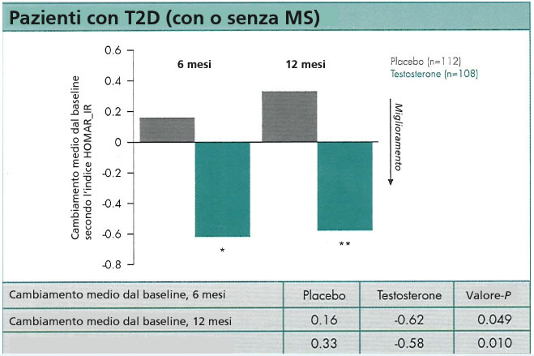
Il testosterone migliora l’insulino-resistenza (3)
Variazioni di HOMA-IR nello studio TIMES2 su 220 pazienti con diabete di tipo 2 in terapia con testosterone gel da 12 mesi
Jones TH et al. Endocrine Soc 2008, Poster P3–422.
Notes:
Reference
Jones TH et al. Endocrine Soc . 2008, Poster P3-422.<<Need copy of poster>>

Slide 9
Il testosterone riduce l’insulino-resistenza (4): risultati di una metanalisi
Differenze della glicemia a digiuno, valori medi (mmol/L)
-16
-14
-12
-10
-0.8
-0.6
-0.4
-0.2
0
0.2
0.4
0.6
A favore di TRT
Differenze indice HOMA, valori medi
Corona G et al. J Sex Med. Published online August 30, 2010.
Notes:
References
Corona G, Monami M, Rastrelli G, Aversa A, Tishova Y, Saad F, Lenzi A, Forti G, Mannucci, E, Maggi M. Testosterone and metabolic syndrome: a meta-analysis study. J Sex Med. 2011;8(1):272-83.<<Ap279 Figure 4.>>
9

Slide 10
Il testosterone ed effetti antinfiammatori (1)
Variazioni di PCR e TNF-α in uomini affetti da ipogonadismo e sindrome metabolica che assumono TU (n=113) o un placebo (n=71)
(Range normale: 0–5)
(Range normale: 0)
Testosterone
Placebo
p=0.03
p<0.001
Kalinchenko S et al. Clin Endocrinol. 2010;73(5):602–612.
Notes:
References
Kalinchenko SY, Tishova YA, Mskhalaya GJ et al. Effects of testosterone supplementation on markers of the metabolic syndrome and inflammation in hypogonadal men with the metabolic syndrome: the double-blinded placebo-controlled Moscow study. Clin Endocrinol (Oxf). 2010 Nov;73(5):602-12. doi: 10.1111/j.1365-2265.2010.03845.x.<<Only have abstract.>>

Slide 11
Il testosterone ed effetti antinfiammatori (2)
Variazioni dalla baseline di hsCRP (PCR ad alta sensibilità) dopo 12 mesi di placebo (n=10) o Nebido® (n=40); gli uomini P^N sono passati dal placebo a Nebido® dopo 12 mesi per un totale di 24 mesi
p=0.001
Aversa A et al. J Sex Med 2010;7(10):3495–3503.
Notes:
11
Notes
AIM: To evaluate the effects of parenteral testosterone undecanoate (TU) in outclinic patients with metabolic syndrome (MS) and late-onset hypogonadism (total testosterone (T) at or below 11nmol/L or free T at or below 250pmol/L).
METHODS: This is a randomized, double-blind, double-dummy, placebo-controlled, parallel group, single-center study. Fifty patients (mean age 57±8) were randomized (4:1) to receive TU 1,000mg (every 12 weeks) or placebo (PLB) gel (3-6 g/daily) for 24 months.
MAIN OUTCOME MEASURES: Homeostasis model assessment index of insulin resistance (HOMA-IR), carotid intima media thickness (CIMT), and high-sensitivity C-reactive protein (hsCRP).
RESULTS: At baseline, all patients fulfilled the National Cholesterol Education Program-Third Adult Treatment Panel (NCEP-ATPIII) and International Diabetes Federation (IDF) criteria for the definition of MS. An interim analysis conducted at 12 months showed that TU markedly improved HOMA-IR (P <0.001), CIMT (P<0.0001), and hsCRP (P<0.001) compared with PLB; thus, all patients were shifted to TU treatment. After 24 months, 35% (P< 0.0001) and 58% (P < 0.001) of patients still presented MS as defined by NCEP-ATPIII and IDF criteria, respectively. Main determinants of changes were reduction in waist circumference (P<0.0001), visceral fat mass (P<0.0001), and improvement in HOMA-IR without changes in body mass index (BMI).
CONCLUSIONS: TU reduced fasting glucose, waist circumference, and improved surrogate markers of atherosclerosis in hypogonadal men with MS. Resumption and maintenance of T levels in the normal range of young adults determines a remarkable reduction in cardiovascular risk factors clustered in MS without significant hematological and prostate adverse events.
The study seems to be valued highly by the Journal of Clinical Endocrinology and Metabolism as it was highlighted by an editorial by Shalender Bhasin. Also, the time between online publication in December 2009 and actual print was very short indicating that it was considered to be of high priority.
References
Aversa A, Bruzziches R, Francomano D et al. Effects of testosterone undecanoate on cardiovascular risk factors and atherosclerosis in middle-aged men with late-onset hypogonadism and metabolic syndrome: results from a 24-month, randomized, double-blind, placebo-controlled study. J Sex Med. 2010;7(10):3495-503. doi: 10.1111/j.1743-6109.2010.01931.x. <<Only have abstract>>

Slide 12
Il testosterone ed effetti antinfiammatori (3)
Lo spessore medio intimale carotideo (Carotid Intima Media Thickness, CIMT) dopo 12 mesi di terapia con testosterone undecanoato (n=40) e correlazione tra la variazione di testosterone e CIMT
CIMT
Correlazione di ΔCIMT vs ΔTotal T
r⁵ = 0.31; p < 0.0001
p<0.0001
Aversa A et al. J Sex Med 2010;7(10):3495–3503.
Notes:
12
Notes
AIM: To evaluate the effects of parenteral testosterone undecanoate (TU) in outpatients with metabolic syndrome (MS) and late-onset hypogonadism (total testosterone (T) at or below 11nmol/L or free T at or below 250pmol/L).
METHODS: This is a randomized, double-blind, double-dummy, placebo-controlled, parallel group, single-center study. Fifty patients (mean age 57±8) were randomized (4:1) to receive TU 1,000mg (every 12 weeks) or placebo (PLB) gel (3-6 g/daily) for 24 months.
MAIN OUTCOME MEASURES: Homeostasis model assessment index of insulin resistance (HOMA-IR), carotid intima media thickness (CIMT), and high-sensitivity C-reactive protein (hsCRP).
RESULTS: At baseline, all patients fulfilled the National Cholesterol Education Program-Third Adult Treatment Panel (NCEP-ATPIII) and International Diabetes Federation (IDF) criteria for the definition of MS. An interim analysis conducted at 12 months showed that TU markedly improved HOMA-IR (P <0.001), CIMT (P<0.0001), and hsCRP (P<0.001) compared with PLB; thus, all patients were shifted to TU treatment. After 24 months, 35% (P< 0.0001) and 58% (P < 0.001) of patients still presented MS as defined by NCEP-ATPIII and IDF criteria, respectively. Main determinants of changes were reduction in waist circumference (P<0.0001), visceral fat mass (P<0.0001), and improvement in HOMA-IR without changes in body mass index (BMI).
CONCLUSIONS: TU reduced fasting glucose, waist circumference, and improved surrogate markers of atherosclerosis in hypogonadal men with MS. Resumption and maintenance of T levels in the normal range of young adults determines a remarkable reduction in cardiovascular risk factors clustered in MS without significant hematological and prostate adverse events.
The study seems to be valued highly by the Journal of Clinical Endocrinology and Metabolism as it was highlighted by an editorial by Shalender Bhasin. Also, the time between online publication in December 2009 and actual print was very short indicating that it was considered to be of high priority.
References
Aversa A, Bruzziches R, Francomano D et al. Effects of testosterone undecanoate on cardiovascular risk factors and atherosclerosis in middle-aged men with late-onset hypogonadism and metabolic syndrome: results from a 24-month, randomized, double-blind, placebo-controlled study. J Sex Med. 2010;7(10):3495-503. doi: 10.1111/j.1743-6109.2010.01931.x. <<Only have abstract>>

Slide 13
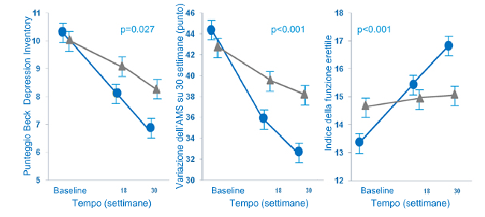
Il testosterone migliora la funzione psicosessuale (1)
Variazioni nel tempo dei punteggi della scala per la depressione (Beck Depr. Inventory, BDI), scala dei sintomi dell’invecchiamento maschile (AMS) e l’Indice internazionale della funzione erettile (IIEF) in uomini affetti da ipogonadismo e sindrome metabolica che assumono TU (n=113) o il placebo (n=71)
Giltay E et al. J Sex Med 2010;7(7):2572–2582.
Notes:
Notes
Low testosterone levels in men are associated with the metabolic syndrome (MetS) as well as with depressive symptoms, low vitality, and sexual dysfunction.
AIM: To assess the effects of testosterone administration on these subjective symptoms, which have not extensively been studied in hypogonadal men with the MetS.
MAIN OUTCOME MEASURES: The Beck Depression Inventory (BDI-IA), Aging Males' Symptoms (AMS) scale, and International Index of Erectile Function 5-item (IIEF-5) scale at baseline, 18 and 30 weeks were analysed using multilevel analysis.
METHODS: In a randomized, placebo-controlled, double-blind, phase III, 184 men suffering from both the MetS and hypogonadism were included. They were treated for 30 weeks with either parenteral testosterone undecanoate (TU; 1,000 mg IM TU, at baseline, and after 6 and 18 weeks; Nebido or placebo injections, 105 (92.9%) men receiving TU and 65 (91.5%) receiving placebo completed the 30-week trial.
RESULTS: The 184 men were aged mean 52.1 years old (standard deviation [SD] 9.6; range 35-69), with a mean body mass index of 35.5 kg/m(2) (SD 6.7; range 25.1-54.8), and a mean total testosterone level of 8.0 nmol/L (SD 4.0). There were significant improvements in BDI-IA (mean difference vs. placebo after 30 weeks: -2.5 points; 95% confidence interval [CI]: -0.9; -4.1; P = 0.003), AMS (-7.4 points; 95% CI: -4.3; -10.5; P < 0.001), and IIEF-5 (+3.1 points; 95% CI: +1.8; +4.4; P < 0.001). The effects on the BDI-IA, AMS, and IIEF-5 were strongest in men with baseline total testosterone levels <7.7 mmol/L (i.e., median value).
CONCLUSIONS: TU administration may improve depressive symptoms, aging male symptoms and sexual dysfunction in hypogonadal men with the MetS. The beneficial effects of testosterone were most evident in men with the lowest baseline total testosterone levels
References
Giltay E et al. J Sex Med. Effects of testosterone supplementation on depressive symptoms and sexual dysfunction in hypogonadal men with the metabolic syndrome. 2010; 7(7): 2572-2582.<<Only have abstract>>>

Slide 14
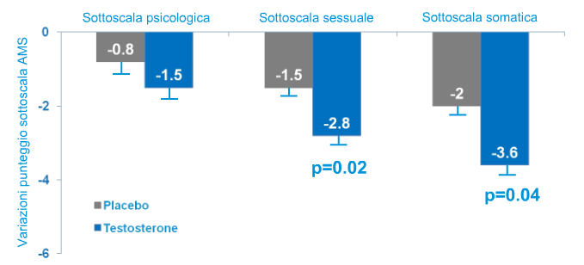
Il testosterone mgliora la funzione psicosessuale (2)
Variazioni della qualità di vita misurata con AMS in 262 uomini anziani fragili in terapia per 6 mesi con testosterone vs placebo
Srinivas-Shankar U et al. J Clin Endocrinol Metab 2010;95(2):639–650.
Notes:
References
Srinivas-Shankar U, Roberts SA, Connolly MJ, et al. Effects of testosterone on muscle strength, physical function, body composition, and quality of life in intermediate-frail and frail elderly men: a randomized, double-blind, placebo-controlled study. J Clin Endocrinol Metab. 2010;95(2):639–650.<<Bp644 Table 2.>>

Slide 15
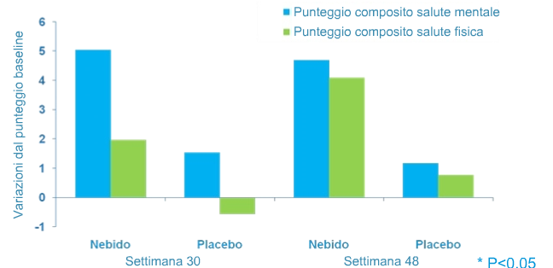
Il testosterone migliora la funzione psicosessuale (3)
Variazione rispetto al basale del questionario SF-12, in 114 uomini della Malesia con ipogonadismo dopo un anno di terapia con T
Tong S et al. J Men’s Health 2010;7(3):323.
Notes:
References
Tong S et al. J Men’s Health. 2010;7(3):323.<<to be confirmed.>>

Slide 16
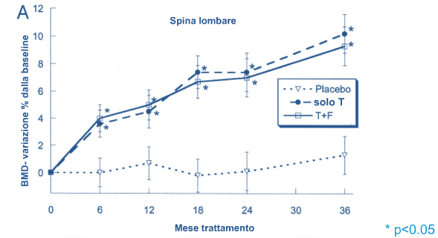
Il testosterone migliora la densità minerale ossea (BMD)
BMD (spina lombare) dopo 36 mesi di testosterone (T), con e senza finasteride
Amory JK et al. J Clin Endocrinol Metab 200489(2):503–510.
Notes:
Notes
Seventy men aged 65 yr or older, with a serum T less than 12.1 nmol/ L on two occasions, were randomly assigned to receive one of three regimens for 36 months: T enanthate, 200 mg IM every 2 wk with placebo pills daily (T-only); T enanthate, 200 mg every 2 wk with 5 mg F daily (TF); or placebo injections and pills (placebo). Low BMD was not an inclusion criterion.
Obtained serial measurements of BMD of the lumbar spine and hip by dual x-ray absorptiometry.
Fifty men completed the 36-month protocol. By an intent-totreat analysis including all men for as long as they contributed data, T therapy for 36 months increased BMD in these men at the lumbar spine [10.2 1.4% (mean percentage increase from
baseline SEM; T-only) and 9.3 1.4% (TF) vs. 1.3 1.4% for placebo (P<0.001)] and in the hip [2.70.7% (T-only) and 2.2 0.7% (TF) vs. 0.2 0.7% for placebo, (P < 0.02)]. Significant increases in BMD were seen also in the intertrochanteric and
trochanteric regions of the hip.
Reference
Amory JK, Watts NB, Easley KA et al. Exogenous testosterone or testosterone with finasteride increases bone mineral density in older men with low serum testosterone. J Clin Endocrinol Metab. 2004;89(2):503-10.<<Ap507 Figure 2>>

Slide 17
Testosterone undecanoato IM a lunga durata azione (Nebid®)

Slide 18
Nebid®: Testosterone undecanoato (TU) a lunga durata d’azione
Nebid® è la prima iniezione di testosterone a lungo effetto per la cura dell’ipogonadismo maschile
Unisce alla sua unica formula galenica a lento rilascio di testosterone un profilo farmacocinetico favorevole
-La componente farmacologica di Nebid® è il testosterone undeconoato (TU)
-Dopo il rilascio, il TU si divide in testosterone attivo e acido grasso libero
Nei soggetti con deficit di testosterone, Nebid® fa aumentare i livelli sierici di testosterone fino al range nomale o eugonadico
Grazie alla sua lunga durata d’azione i livelli normali di testosterone sono mantenuti costanti durante il trattamento a lungo termine, portando ad un miglioramento clinico dei sintomi dell’ipogonadismo con solo 4-5 iniezioni all’anno (intervallo di dosaggio di 12 settimane).

Slide 19
Il TU mantiene costanti livelli di testosterone sierico(1)
Farmacocinetica del testosterone enantato (TE) e testosterone undecanoato (TU) IM in uomini affetti da ipogonadismo*
60
250 mg TE
50
1000 mg TU
40
30
Testosterone sierico (nmol/L)
Range normale
10–35 nmol/L
20
10
0
0
2
4
6
8
10
12
Settimane dopo singola somministrazione
* Livelli di testosterone basale <6 nmol/L
Nieschlag and Behre 1996.
Notes:
Reference to be confirmed.

Slide 20
TU ha un’azione efficace negli uomini affetti da disfunzione sessuale e sindrome metabolica
In una coorte di uomini di età compresa tra i 54 e i 76 anni (età media 64 anni) affetti da disfunzione sessuale con segni di sindrome metabolica, la somministrazione di TU per 12 mesi ha:
  ripristinato i livelli di T nel plasma ai livelli medi del range dei valori di riferimento
  avuto effetto positivo sulla funzione sessuale (miglioramento del punteggio sulla scala IIEF)
  migliorato la scala Aging Males’ Symptoms scale (AMS)
  migliorato i parametri della sindrome metabolica:
    Diminuzione della circonferenza addominale
    Diminuzione del colesterolo plasmatico e del colesterolo LDL
    Aumento dell’HDL plasmatico
    Inizialmente l’SHBG (un indicatore della gravità della sindrome metabolica) è diminuito, probabilmente a causa dell’aumento dei livelli plasmatici di T; in seguito è aumentato al crescere del T plasmatico – potrebbe indicare un miglioramento della sindrome metabolica
    La pressione sanguigna è leggermente aumentata, in maniera significativa
SHBG = globuline leganti gli ormoni sessuali.
Notes:
Notes
Administration of testosterone undecanoate (TU) over 12 months to men with sexual dysfunction and signs of the metabolic syndrome, restored their plasma testosterone (T) levels to the mid-range of reference values.
This had a beneficial effect on their sexual functioning as evidenced by an improvement of their scores on the International Index of Erectile Function. The scores on the Aging Male Symptoms score, AMS, were also improved.
Most impressive were the improvements in the parameters of the metabolic syndrome; they all improved and appeared largely correlated (i.e., decline in waist circumference with declines of plasma cholesterol and LDL and increase in plasma HDL).
Sex hormone binding globulin, SHBG, may be considered as an indicator of the severity of the metabolic syndrome; levels of SHBG initially fell, probably as a result of rising plasma T levels.
But over the last six months of the observation period when plasma T rose further, there was a significant increase in plasma SHBG which may be interpreted to indicate an improvement of the metabolic syndrome.
Blood pressure improved slightly but significantly.
In this cohort of elderly men (54–76 years; median 64 years) there were no safety concerns over a one year period of T administration.
References
Saad F, Gooren L, Haider A, Yassin A. An exploratory study of the effects of 12 month administration of the novel long-acting testosterone undecanoate on measures of sexual function and the metabolic syndrome. Arch Androl. 2007;53(6):353-7.

Slide 21
Effetto del trattamento con Nebid® su Indice internazionale della funzione erettile (IIEF) in uomini con DE affetti da ipogonadismo
20
*
*
18
*
*
16
14
12
10
8
6
4
2
0
Baseline
3 mesi
6 mesi
9 mesi
12 mesi
n=28
Età media: 64 anni, range: 54–76
Range di riferimento SHBG: 10–73 nmol/L
*p<0.05 vs. valore precedente
Saad F et al. Arch Androl 2007;53:353–357.
Notes:
References
Saad F, Gooren L, Haider A, Yassin A. An exploratory study of the effects of 12 month administration of the novel long-acting testosterone undecanoate on measures of sexual function and the metabolic syndrome. Arch Androl. 2007;53(6):353-7.

Slide 22
Normalizzazione della funzione erettile in pazienti ipogonadici (con funzione erettile normale al basale), dopo 6 e dopo 24 settimane di terapia con testosterone undecanoato (TU)
100
80
60
Pazienti (%)
54 %
40
20
13 %
0
Baseline
(n=22)
Miglioramento alla 6 sett.
(n=3)
Miglioramento alla 24 sett.
(n=12)
Yassin A & Saad F J. Sex Med 2007;4:497–501.
Notes:
References
Yassin AA, Saad F. Improvement of sexual function in men with late-onset hypogonadism treated with testosterone only. J Sex Med. 2007 Mar;4(2):497-501.

Slide 23
Effetto sulla Scala dei sintomi dell’invecchiamento maschile (AMS) in soggetti ipogonadici e con DE del trattamento con Nebid®
55
50
45
40
35
*
30
*
25
20
15
10
5
0
Baseline
3 mesi
6 mesi
9 mesi
12 mesi
* n=28
Età media: 64 anni, range: 54–76
Range di riferimento SHBG: 10–73 nmol/L
* p<0.05 vs. valore precedente
Saad F et al. Arch Androl 2007;53:353–357.
Notes:
References
Saad F, Gooren L, Haider A, Yassin A. An exploratory study of the effects of 12 month administration of the novel long-acting testosterone undecanoate on measures of sexual function and the metabolic syndrome. Arch Androl. 2007;53(6):353-7.

Slide 24
Effetto del trattamento con Nebid® sulla circonferenza addominale in soggetti ipogonadici con DE
110
105
*
100
*
Circonfeneza addominale (cm)
*
95
90
85
80
Baseline
3 mesi
6 mesi
9 mesi
12 mesi
* n=28
Età media 64 anni, range: 54–76
Range di riferimento SHBG: 10–73 nmol/L
* p<0.05 vs. valore precedente
Saad F et al. Arch Androl 2007;53:353–357.
Notes:
References
Saad F, Gooren L, Haider A, Yassin A. An exploratory study of the effects of 12 month administration of the novel long-acting testosterone undecanoate on measures of sexual function and the metabolic syndrome. Arch Androl. 2007;53(6):353-7.

Slide 25
Effetto del trattamento con Nebid® su colesterolo totale in soggetti ipogonadici con DE
300
Valore normale <220 mg/dL
250
*
*
*
Concentrazione di colesterolo totale (mg/dL)
200
150
100
Baseline
3 mesi
6 mesi
9 mesi
12 mesi
* n=28
Età media: 64 anni, range: 54–76
* p<0.05 vs. valore precedente
Saad F et al. Arch Androl 2007;53:353–357.
Notes:
References
Saad F, Gooren L, Haider A, Yassin A. An exploratory study of the effects of 12 month administration of the novel long-acting testosterone undecanoate on measures of sexual function and the metabolic syndrome. Arch Androl. 2007;53(6):353-7.

Slide 26
Effetto del trattamento con Nebid® su colesterolo LDL in soggetti ipogonadici con DE
200
Valore normale <150 mg/dL
180
160
Concentrazione di colesterolo (mg/dL)
*
140
*
120
100
Baseline
3 masi
6 mesi
9 mesi
12 mesi
* n=28
Età media: 64 yanni, range: 54–76
* p<0.05 vs. valore precedente
Saad F et al. Arch Androl 2007;53:353–357.
Notes:
References
Saad F, Gooren L, Haider A, Yassin A. An exploratory study of the effects of 12 month administration of the novel long-acting testosterone undecanoate on measures of sexual function and the metabolic syndrome. Arch Androl. 2007;53(6):353-7.

Slide 27
Effetto del trattamento con Nebid® sui Trigliceridi in soggetti ipogonadici con DE
320
300
Valore normale <180 mg/dL
280
260
Concentrazione di colesterolo (mg/dL)
240
*
220
*
200
*
180
Baseline
3 mesi
6 mesi
9 mesi
12 mesi
* n=28
Età media: 64 anni, range: 54–76
* p<0.05 vs. valore precedente
Saad F et al. Arch Androl 2007;53:353–357.
Notes:
References
Saad F, Gooren L, Haider A, Yassin A. An exploratory study of the effects of 12 month administration of the novel long-acting testosterone undecanoate on measures of sexual function and the metabolic syndrome. Arch Androl. 2007;53(6):353-7.

Slide 28
Effetto del trattamento con Nebid® su Colesterolo HDL in soggetti ipogonadici con DE
60
*
*
50
*
40
Concentrazione di colesterolo (mg/dL)
30
20
10
0
Baseline
3 mesi
6 mesi
9 mesi
12 mesi
* n=28
Età media: 64 anni, range: 54–76
*p<0.05 vs. Valore precedente
Saad F et al. Arch Androl 2007;53:353–357.
Notes:
References
Saad F, Gooren L, Haider A, Yassin A. An exploratory study of the effects of 12 month administration of the novel long-acting testosterone undecanoate on measures of sexual function and the metabolic syndrome. Arch Androl. 2007;53(6):353-7.

Slide 29
Rassegna delle diverse formulazioni

Slide 30
Formulazione ideale di testosterone
Raggiunge e mantiene un livello fisiologico di testosterone
Assicura un profilo di sicurezza favorevole
Posologia e schemi di somministrazione comodi
Costo ragionevole per il paziente
Edelstein D et al. Expert Opin Emerg Drugs 2006;11(4):685–707.
Notes:
Reference
Edelstein D, Dob A, Basaria S. Emerging drugs for hypogonadism. Expert Opin Emerg Drugs. 2006; 11(4): 685-707. <<Not seen – Taken from previous slide set>>

Slide 31
Indicazioni terapeutiche e gruppo target
La terapia sostitutiva con testosterone è indicata per l’ipogonadismo maschile, quando il deficit di testosterone è confermato da sintomi clinici e test biochimici
Uomini (in età compresa tra 20 e 39 anni) con ipogonadismo classico (congenito o correlato a malattia)
-La maggior parte dei quali in corso di terapia
Uomini (di età compresa tra i 40 e i 74 anni) con ipogonadismo classico o correlato all’età
-La maggior parte dei quali non in terapia

Slide 32
Opzioni per la terapia sostitutiva con testosterone (TRT)
La TRT può essere somministrata per via orale, per via transdermica (cerotto o gel), con iniezione intramuscolare (depot o a lento rilascio) o impianto pellet

Slide 33
T undecanoato per via orale (1)
DHT – diidrotestosterone; E2 – estradiolo; T – testosterone
Dose giornaliera
  40-80 mg, due volte al dì o tre volte durante i pasti
Formulazioni disponibili:
  Andriol, Restandol Restinsol, Understor (MSD)
Profilo farmacocinetico
-Somministrato in acido oleico il testosterone undecanoato viene assorbito attraverso il sistema linfatico, bypassando il sistema portale epatico; variazioni considerevoli nello stesso soggetto in giorni differenti e fra soggetti diversi
DHT e E2
-Elevato rapporto DHT:T
DHT – diidrotestosterone; E2 – estradiolo; T – testosterone
.
Bhasin S et al. J Clin Endocrinol Metabol 2010;95:2536–2559.
Notes:
Notes (Buvat J, Maggi M, Gooren L, et al. Endocrine aspects of male sexual dysfunctions. J Sex Med 2010;7;1627–1656. <<Ap1638>>)
The oral route is the easiest one to replace T, but the ingested hormone is
almost completely inactivated by its first pass through the liver: It is therefore difficult to achieve sustained blood levels with oral formulations, andmost of them are weakly active.
The only active and safe oral formulation is the T undecanoate (TU), in oleic acid or in a mixture of castor oil and propylene glycol laureate. However, its absorption is variable.
References for slide
Bhasin S, Cunningham GR, Hayes FJ, et al. Testosterone therapy in men with androgen deficiency syndromes: an endocrine society clinical practice guideline. J Clin Endocrinol Metabol. 2010; 95:2536–2559.<<Ap2548 Table 6>>

Slide 34
T undecanoato per via orale (2)
Vantaggi
Comodità della somministrazione per via orale
Svantaggi
Risposte cliniche variabili
Livelli di T sierico variabili
Elevato rapporto DHT:T
Non approvato negli Stati Uniti
DHT – dihydrotestosterone; E2 –estradiol; T – testosterone.
Bhasin S et al. J Clin Endocrinol Metabol 2010;95:2536–2559.
Notes:
References for slide
Bhasin S, Cunningham GR, Hayes FJ, et al. Testosterone therapy in men with androgen deficiency syndromes: an endocrine society clinical practice guideline. J Clin Endocrinol Metabol. 2010; 95:2536–2559.<<Ap2548 Table 6>>

Slide 35
Testosterone iniezione IM depot (1)
DHT – diidrotestosterone; E2 – estradiolo; T – testosterone
Dosaggio giornaliero
T enantato o cipionato 50-250 mg IM ogni 2-4 settimane o 75-100 mg a settimana
T propionato 50-250 mg
Le formulazioni disponibili:
Iniezione di testosterone enantato da 250 mg
-Testoviron Depot (Bayer HC)
Iniezione di testosterone propionato da 100 mg
-Sustanon 100 (MSD)
Iniezione di esteri misti del testosterone da 250 mg
-Sustanon 250 (MSD)
Profilo farmacocinetico
Dopo una singola iniezione IM, i livelli di T sierico si innalzano al di sopra del range eugonadico, poi declinano gradualmente fino a tornare al range ipogonadico
DHT e E2
I livelli di DHT e E2 aumentano in proporzione all’aumento dei livelli di T
I rapporti T:DHT e T:E2 rimangono immutati
DHT – diidrotestosterone; E2 – estradiolo; T – testosterone
.
Buvat J et al. J Sex Med 2010;7;1627–1656.
Bhasin S et al. J Clin Endocrinol Metabol 2010;95:2536–2559.
Notes:
Notes
The IM of T administered in oily depot includes short- and long-acting preparations. The short-acting T enanthate and cypionate must be injected at intervals of 2–4 weeks.
Such injections generally induce supraphysiological serum peak levels of T for 2–5 days after injection, followed by a rapid decline to subphysiological levels in 10–14 days.¹
These highs and lows of T may produce unpleasant fluctuations in patient’s mood, sexual desire and activity, and energy level.¹
References
Buvat J, Maggi M, Gooren L, et al. Endocrine aspects of male sexual dysfunctions. J Sex Med 2010;7;1627–1656. <<Ap1639 Table2, Bp1639>>)
Bhasin S, Cunningham GR, Hayes FJ, et al. Testosterone therapy in men with androgen deficiency syndromes: an endocrine society clinical practice guideline. J Clin Endocrinol Metabol. 2010; 95:2536–2559.<<Ap2547 Table 6>>

Slide 36
Testosterone iniezione IM depot (2)
DHT – diidrotestosterone; E2 – estradiolo; T – testosterone
Vantaggi
Risolve i sintomi di deficienza androgenica
Relativamente economico
Flessibilità di dosaggio
Svantaggi
Richiede un’iniezione IM
Alti e bassi nei livelli di T sierico (fino a scendere al livello ipogonadico se la dose non è abbastanza frequente)
DHT – dihydrotestosterone; E2 – estradiol; T – testosterone.
Bhasin S et al. J Clin Endocrinol Metabol 2010;95:2536–2559.
Notes:
Notes
The short-acting T enanthate and cypionate must be injected at intervals of 2–4 weeks.
Such injections generally induce supraphysiological serum peak levels of T for 2–5 days after injection, followed by a rapid decline to subphysiological levels in 10–14 days.¹
These highs and lows of T may produce unpleasant fluctuations in patient’s mood, sexual desire and activity, and energy level.¹
References
Buvat J, Maggi M, Gooren L, et al. Endocrine aspects of male sexual dysfunctions. J Sex Med 2010;7;1627–1656. <<Ap1639 Table2; Bp1639 >>)
Bhasin S, Cunningham GR, Hayes FJ, et al. Testosterone therapy in men with androgen deficiency syndromes: an endocrine society clinical practice guideline. J Clin Endocrinol Metabol. 2010; 95:2536–2559.<<Ap2547 Table 6>>

Slide 37
Testosterone iniezione IM ad azione prolungata (1)
Dosaggio giornaliero
Regime europeo 1000 mg IM, seguiti da 1000 mg alla sesta settimana, poi 1000mg ogni 10-14 settimane
Formulazioni disponibili:
Nebido/Nebid ® (Bayer HealthCare)
Profilo farmacocinetico
I livelli di T sierico vengono mantenuti nel range normale nella maggior parte degli uomini trattati con iniezioni IM alla dose di 750-1000mg
DHT e E2
I livelli di DHT e E2 aumentano in proporzione all’aumento dei livelli di T
I rapporti T:DHT e T:E2 rimangono immutati
DHT – diidrotestosterone; E2 – estradiolo; T – testosterone
.
Buvat J et al. J Sex Med 2010;7;1627–1656.
Bhasin S et al. J Clin Endocrinol Metabol 2010;95:2536–2559.
Notes:
Notes
Nebido is injectable long-acting T undeconoate in oil.
Long-acting T undecanoate shows more favuorable kinetics with serum T levels in the mid-normal range for about 12 weeks, and thus requires only four to five injections of 1,000 mg per year. ¹
Consequently, the side-effects due to the serum fluctuation levels of T are not observed with this formulation, in contrast to the shorter acting T propionate and T cypionate.¹
References
Buvat J, Maggi M, Gooren L, et al. Endocrine aspects of male sexual dysfunctions. J Sex Med 2010;7;1627–1656. <<Ap1639A Table 2, Cp1639>>)
Bhasin S, Cunningham GR, Hayes FJ, et al. Testosterone therapy in men with androgen deficiency syndromes: an endocrine society clinical practice guideline. J Clin Endocrinol Metabol. 2010; 95:2536–2559.<<Bp2548 Table 6>>

Slide 38
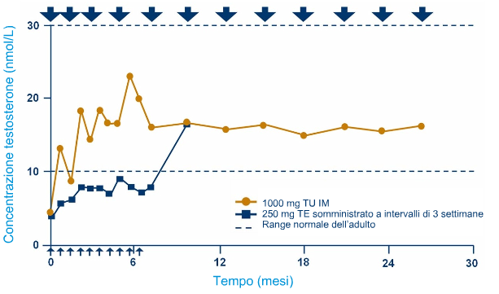
Farmacocinetica: testosterone undecanoato (TU) vs testosterone enantato
Schubert M et al. J Clin Endocrinol Metab 2004;89:5429–5434.
Notes:
References
Schubert M, Minnemann T, Hübler D, et al. Intramuscular testosterone undecanoate: pharmacokinetic aspects of a novel testosterone formulation during long-term treatment of men with hypogonadism. J Clin Endocrinol Metab. 2004;89:5429-5434.<<Ap5432 Figure 2>>

Slide 39
Testosterone iniezione IM ad azione prolungata (2)
Vantaggi
Risolve i sintomi della deficienza androgenica
Richiede una bassa frequenza di somministrazione
Evita fluttuazioni dei livelli di testosterone
Ha meno effetti avversi
Svantaggi
Richiede un’iniezione IM di volume considerevole (4mL)
Un piccolo numero di uomini ha riportato un episodio di tosse subito dopo l’iniezione
DHT – dihydrotestosterone; E2 – estradiol; T – testosterone.
Buvat J et al. J Sex Med 2010;7;1627–1656.
Bhasin S et al. J Clin Endocrinol Metabol 2010;95:2536–2559.
Notes:
Notes
Nebido is injectable long-acting T undeconoate in oil.
Long-acting T undecanoate shows more favorable kinetics with serum T levels in the mid-normal range for about 12 weeks, and thus requires only four to five injections of 1,000 mg per year. ¹
Consequently, the side-effects due to the serum fluctuation levels of T are not observed with this formulation, in contrast to the shorter acting T propionate and T cypionate.¹
References
Buvat J, Maggi M, Gooren L, et al. Endocrine aspects of male sexual dysfunctions. J Sex Med 2010;7;1627–1656. <<Ap1639A Table 2, Cp1639>>)
Bhasin S, Cunningham GR, Hayes FJ, et al. Testosterone therapy in men with androgen deficiency syndromes: an endocrine society clinical practice guideline. J Clin Endocrinol Metabol. 2010; 95:2536–2559.<<Bp2548 Table 6>>

Slide 40
Impianti con testosterone (1)
Dosaggio
La dose e il regime variano a seconda della formulazione
3-6 pellet impiantati SC (sottocute)
100-600mg necessari ogni 4-5 mesi
Le formulazioni disponibili:
Impianti di testosterone da 50 mg, 100 mg o 200mg (MSD)
Profilo farmacocinetico
Il T sierico raggiunge il picco dopo un mese e perdura nel range normale per 3-6 mesi, a seconda della formulazione
DHT – diidrotestosterone; E2 – estradiolo; T – testosterone
.
Buvat J et al. J Sex Med 2010;7;1627–1656.
Bhasin S et al. J Clin Endocrinol Metabol 2010;95:2536–2559.
Notes:
Notes
Subdermal pellet implants of T have a prolonged period of action (around 6 months). They need to be implanted by a specialist and expose the patients to risks of infection (uncommon) an spontaneous extrusion of the pellet.¹
References
Buvat J, Maggi M, Gooren L, et al. Endocrine aspects of male sexual dysfunctions. J Sex Med 2010;7;1627–1656. <<Dp1639>>)
Bhasin S, Cunningham GR, Hayes FJ, et al. Testosterone therapy in men with androgen deficiency syndromes: an endocrine society clinical practice guideline. J Clin Endocrinol Metabol. 2010; 95:2536–2559.<<Bp2547 Table 6>>

Slide 41
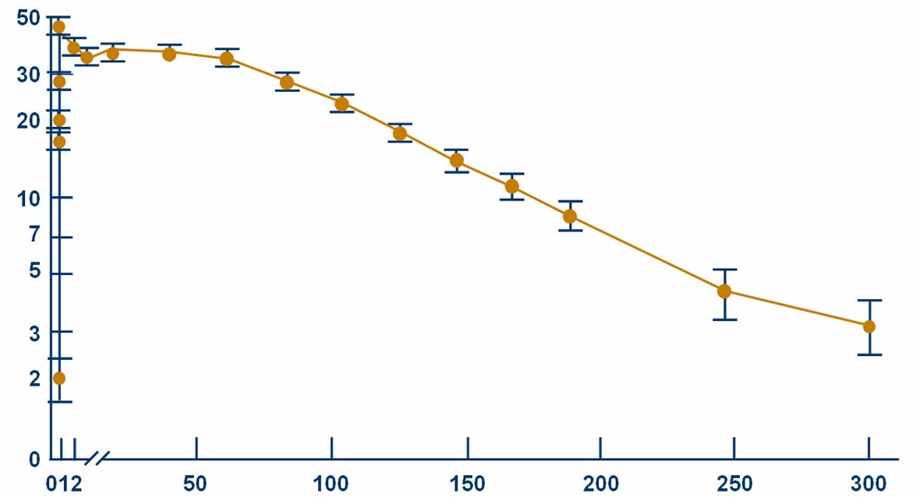
Farmacocinetica: impianti pellet
Concentrazione di testosterone (nmol/L)
Tempo (giorni)
Jockenhovel F et al. Clin Endocrinol 1996;45:61–71.
Notes:
References
Jockenhövel F, Vogel E, Kreutzer M et al. Pharmacokinetics and pharmacodynamics of subcutaneous testosterone implants in hypogonadal men. Clin Endocrinol (Oxf). 1996;45(1):61–71.<<Not seen from previous slide set.>>

Slide 42
Impianti con testosterone (2)
Vantaggi
Risolve i sintomi della carenza androgenica
Svantaggi
Necessita di un’incisione chirurgica per l’inserzione
Rischio di infezione o estrusione spontanea del pellet nel 5-14% dei casi
DHT – dihydrotestosterone; E2 – estradiol; T – testosterone.
Buvat J et al. J Sex Med. 2010;7;1627–1656.
Bhasin S et al. J Clin Endocrinol Metabol. 2010;95:2536–2559.
Notes:
Notes
Subdermal pellet implants of T have a prolonged period of action (around 6 months).
They need to be implanted by a specialist and exposes the patients to uncommon risks of infection or spontaneous extrusion of the pellet.¹
References
Buvat J, Maggi M, Gooren L, et al. Endocrine aspects of male sexual dysfunctions. J Sex Med 2010;7;1627–1656. <<Dp1639>>)
Bhasin S, Cunningham GR, Hayes FJ, et al. Testosterone therapy in men with androgen deficiency syndromes: an endocrine society clinical practice guideline. J Clin Endocrinol Metabol. 2010; 95:2536–2559.<<Bp2547 Table 6>>

Slide 43
Testosterone transdermico (1)
Dosaggio
Testosterone gel 1%: 50-100 mg ogni giorno (rilascia 5-10 mg di testosterone)
Cerotto transdermico: 1 o 2 cerotti, rilascia teoricamente 5-10mg T nel corso di 24 h, applicato giornalmente su zone non sottoposte a pressione
Le formulazioni disponibili:
Cerotto transdermico di testosterone:
-Andropatch/Androderm (GSK)
Testosterone gel
-Testogel (BayerHealthCare)
Testim (Ipsen)
-Tostran/Tostrex (ProStrakan)
Profilo farmacocinetico:
T gel: ripristina il T sierico e i livelli di E2 ai livelli fisiologici
T cerotti: ripristinano i livelli di T sierico, DHT e E2 ai livelli del range fisiologico maschile
DHT e E2
Livelli di DHT sierico più alti e rapporti T:DHT più bassi negli uomini ipogonadici sotto terapia T gel rispetto agli uomini eugonadici
T cerotti: i livelli T:DHT e T:E2 sono nel range fisiologico maschile
DHT – diidrotestosterone; E2 – estradiolo; T – testosterone
.
Buvat J et al. J Sex Med 2010;7;1627–1656.
Bhasin S et al. ed. J Clin Endocrinol Metabol 2010;95:2536–2559.
Notes:
Notes
Transdermal preparations are available either as skin patches or as hydroalcoholic gel and are designed to deliver 5–10 mg of T per day.¹
They should be used daily or every other day for one recent brand of patch, and normally provide uniform T serum levels during the treatment.¹
The patches can be scrotal or non-scrotal. ¹
Skin irritation is a common side-effect with the patches but uncommon with the gel. Patient’s compliance with T gel seems much better than with T patches, but the possibility of T transfer from gel-treated males to women and children requires specific precautions.¹
References
Buvat J, Maggi M, Gooren L, et al. Endocrine aspects of male sexual dysfunctions. J Sex Med 2010;7;1627–1656. <<Bp1638, Ep1639, Fp1639 Table 2>>)
Bhasin S, Cunningham GR, Hayes FJ, et al. Testosterone therapy in men with androgen deficiency syndromes: an endocrine society clinical practice guideline. J Clin Endocrinol Metabol. 2010; 95:2536–2559.<<Cp2547 Table 6>>

Slide 44
Testosterone transdermico (2)
Vantaggi
T gel
-Risolve i sintomi da carenza androgenica
-Consente flessibilità di dosaggio
- Applicazione facile
-Buona tollerabilità cutanea
T cerotti
-Facilità di applicazione; risolve i sintomi di deficit androgenico
Svantaggi
T gel
-Potenziale rischio di trasferimento al partner o ai figli tramite contatto cutaneo diretto
- Irritazione cutanea in un numero ristretto di uomini in terapia
- Livelli di DHT moderatamente elevati
T cerotti
-I livelli di T sierico in alcuni uomini affetti da deficit androgenico possono rimanere nel range basso-normale; tali soggetti possono necessitare quindi di due cerotti al giorno
-Frequente irritazione cutanea nel sito di applicazione in molti pazienti
DHT – diidrotestosterone; E2 – estradiolo; T – testosterone
.
Buvat J et al. J Sex Med 2010;7;1627–1656.
Bhasin S et al. J Clin Endocrinol Metabol 2010;95:2536–2559.
Notes:
Notes
Transdermal preparations are available either as skin patches or as hydroalcoholic gel and are designed to deliver 5–10 mg of T per day.¹
They should be used daily or every other day for one recent brand of patch, and normally provide uniform T serum levels during the treatment.¹
The patches can be scrotal or non-scrotal. ¹
Skin irritation is a common side-effect with the patches but uncommon with the gel. Patient’s compliance with T gel seems much better than with T patches, but the possibility of T transfer from gel-treated males to women and children requires specific precautions.¹
References
Buvat J, Maggi M, Gooren L, et al. Endocrine aspects of male sexual dysfunctions. J Sex Med 2010;7;1627–1656. <<Bp1638, Ep1639, Fp1639 Table 2>>)
Bhasin S, Cunningham GR, Hayes FJ, et al. Testosterone therapy in men with androgen deficiency syndromes: an endocrine society clinical practice guideline. J Clin Endocrinol Metabol. 2010; 95:2536–2559.<<Cp2547 Table 6>>

Slide 45
Tavolette buccali mucoadesive di testosterone (1)
Dosaggio
Tavolette bioadesive da 30 mg a rilascio controllato, due volte al giorno
Le formulazioni disponibili:
Striant (The Urology Company Ltd)
Profilo farmacocinetico
Viene assorbito tramite la mucosa buccale
DHT e E2
Normalizza i livelli di T sierico e DHT negli uomini ipogonadici
DHT – diidrotestosterone; E2 – estradiolo; T – testosterone
.
Buvat J et al. J Sex Med 2010;7;1627–1656.
Bhasin S et al. J Clin Endocrinol Metabol 2010;95:2536–2559.
Notes:
Notes
Transbuccal administration allows the absorption of T through the oral mucosa, avoiding intestinal passage and liver inactivation.¹
The T is presented as a biopellet to be pressed on the gum above the incisor tooth.¹
References
Buvat J, Maggi M, Gooren L, et al. Endocrine aspects of male sexual dysfunctions. J Sex Med 2010;7;1627–1656. <<Cp1638, Gp1639 Table 2.>>)
Bhasin S, Cunningham GR, Hayes FJ, et al. Testosterone therapy in men with androgen deficiency syndromes: an endocrine society clinical practice guideline. J Clin Endocrinol Metabol. 2010; 95:2536–2559.<<Dp2547 Table 6.>>

Slide 46
Tavolette buccali mucoadesive di testosterone (2)
Vantaggi
Risolve i sintomi della deficienza di androgenica negli uomini sani affetti da ipogonadismo
Facilità d’uso
Svantaggi
Reazioni gengivali avverse nel 16% degli uomini sottoposti alla terapia
DHT – diidrotestosterone; E2 – estradiolo; T – testosterone
.
Buvat J et al. J Sex Med 2010;7;1627–1656.
Bhasin S et al. J Clin Endocrinol Metabol 2010;95:2536–2559.
Notes:
Notes
Transbuccal administration allows the absorption of T through the oral mucosa, avoiding intestinal passage and liver inactivation.¹
The T is presented as a biopellet to be pressed on the gum above the incisor tooth.¹
References
Buvat J, Maggi M, Gooren L, et al. Endocrine aspects of male sexual dysfunctions. J Sex Med 2010;7;1627–1656. <<Cp1638, Gp1639 Table 2.>>)
Bhasin S, Cunningham GR, Hayes FJ, et al. Testosterone therapy in men with androgen deficiency syndromes: an endocrine society clinical practice guideline. J Clin Endocrinol Metabol. 2010; 95:2536–2559.<<Dp2547 Table 6.>>

Slide 47
Riassunto
La terapia sostitutiva con testosterone è sicura ed efficace se usata in maniera appropriata, e porta a un miglioramento o alla scomparsa dei sintomi dell’ipogonadismo
Una opportuna terapia sostitutiva con testosterone permette di raggiungere livelli sierici medio-normali di testosterone costanti nel tempo
Le formulazioni di testosterone offrono varie opzioni terapeutiche al paziente

